Slide 1
Exception handling

Slide 2
What is Exception?
An error occurs during the program execution is called Exception in PL/SQL.
PL/SQL facilitates programmers to catch such conditions using exception block in the program and an appropriate action is taken against the error condition.
There are two type of exceptions:
System-defined Exceptions
User-defined Exceptions

Slide 3
System define exceptions

Slide 4
DECLARE
<declarations section>
BEGIN
<executable command(s)>
EXCEPTION
<exception handling goes here >
WHEN exception1 THEN
exception1-handling-statements
WHEN exception2 THEN
exception2-handling-statements
........
WHEN others THEN
exception3-handling-statements
END;

Slide 5
DECLARE
c_id customers.id%type := 5;
c_name customers.name%type;
c_addr customers.address%type;
BEGIN
SELECT name, address INTO c_name, c_addr
FROM customers
WHERE id = c_id;
DBMS_OUTPUT.PUT_LINE ('Name: '|| c_name);
DBMS_OUTPUT.PUT_LINE ('Address: ' || c_addr);
EXCEPTION
WHEN no_data_found THEN
dbms_output.put_line('No such customer!');
WHEN others THEN
dbms_output.put_line('Error!');
END;
/

Slide 6
User define exceptions

Slide 7
PL/SQL facilitates their users to define their own exceptions according to the need of the program.
A user-defined exception can be raised explicitly, using either a RAISE statement or the procedure DBMS_STANDARD.RAISE_APPLICATION_ERROR.
DECLARE
my-exception EXCEPTION;

Slide 8
Exception | Description
INVALID_CURSOR | It is raised when attempts are made to make a cursor operation that is not allowed, such as closing an unopened cursor.
INVALID_NUMBER | It is raised when the conversion of a character string into a number fails because the string does not represent a valid number.
LOGIN_DENIED | It is raised when s program attempts to log on to the database with an invalid username or password.
NO_DATA_FOUND | It is raised when a select into statement returns no rows.
NOT_LOGGED_ON | It is raised when a database call is issued without being connected to the database.
TOO_MANY_ROWS | It is raised when a SELECT INTO statement returns more than one row.
ZERO_DIVIDE | It is raised when an attempt is made to divide a number by zero.

Slide 9
Functions
subquery,
ROLLUP AND CUBE
Rollback, SavePoint
Data type, Nested Tables, Varrays Rollback Segment

Slide 10
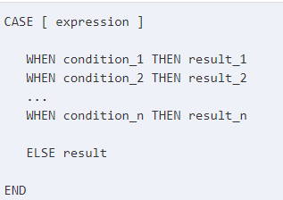
CASE WHEN
Oracle 12c, Oracle 11g, Oracle 10g

Slide 11
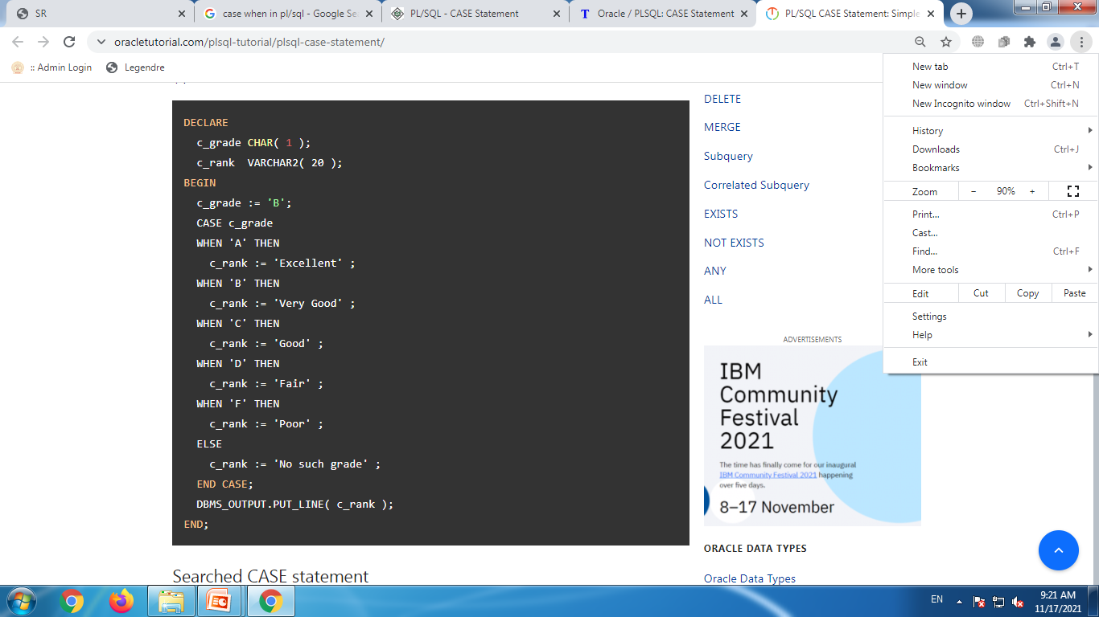

Slide 12
COALESCE()
Syntax:
COALESCE( expr1, expr2, ... expr_n )
Description:
The Oracle/PLSQL COALESCE function returns the first non-null expression in the list.
Oracle 12c, Oracle 11g, Oracle 10g
Example:
SELECT COALESCE(NULL, 'meghna', NULL, NULL, 'Example.com');

Slide 13
Decode()
Syntax:
DECODE( expression , search , result [, search , result]... [, default] )
Description:
Oracle 12c, Oracle 11g, Oracle 10
The Oracle/PLSQL DECODE function has the functionality of an IF-THEN-ELSE statement.

Slide 14
Example
Example:
SELECT supplier_name, DECODE(supplier_id, 10000, 'IBM', 10001, 'Microsoft', 10002, 'Hewlett Packard', 'Gateway') result FROM suppliers;

Slide 15
Soundex()
Syntax:
SOUNDEX( string1 )
Description:
The Oracle/PLSQL SOUNDEX function returns a phonetic representation (the way it sounds) of a string.
Oracle 12c, Oracle 11g, Oracle 10g, Oracle 9i
Example:
SELECT COALESCE(NULL, 'meghna', NULL, NULL, 'Example.com');

Slide 16
Database link
A database link is a connection between two physical database servers that allows a client to access them as one logical database.
You can also access remote tables and views using any INSERT, UPDATE, DELETE, or LOCK TABLE statement.
Use the CREATE DATABASE LINK statement to create a database link

Slide 17
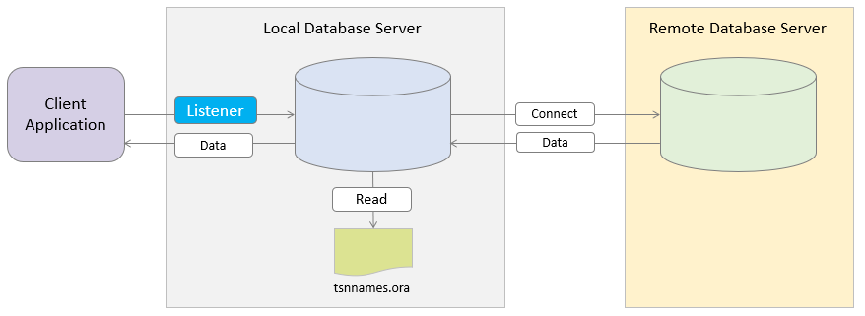

Slide 18
CREATE DATABASE LINK dblink CONNECT TO remote_user IDENTIFIED BY password USING 'remote_database';

Slide 19
snapshot
A recent copy of a table or a subset of rows or cols of a table is called as snapshot in oracle.
A snapshot is more useful in distributed computing environment.
We can create snapshot in oracle using command create snapshot.
We can specify refresh interval while creating snapshot

Slide 20
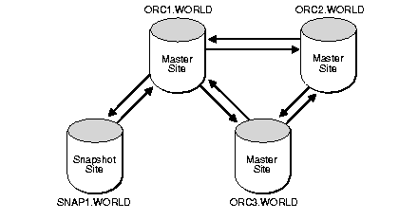

Slide 21
varray
A varying array allows you to repeating attributes of a record in a single row.
You can create a varying array based on either an abstract data type or one of oracle's standard data types such as NUMBER.

Slide 22
varray
Syntax:
CREATE OR REPLACE TYPE <typename> AS VARRAY(<size>) OF <data_type> (<size>);
Example:
CREATE OR REPLACE TYPE MARKS_VA AS VARRAY(5) OF NUMBER(3);

Slide 23
Nested table
Table inside table
A nested table is a table that is represented as a column within another table it means nested table is a table within another table.
We can have multiple rows in the nested table for each row in the main table.

Slide 24
Nested table
To create nested table:
First create an abstract type
Create a type that hold abstract type
Create table & store nested table inside it

Slide 25
Nested table example
First create an abstract type
CREATE OR REPLACE TYPE add1(streetno varchar(10),pin number(3));
Create a type that hold abstract type
Create type adata as table of add1;
Create a table that hold abstract type in side field
CREATE TABLE stud (rlno number(2),nm char(5),address adata) NESTED TABLE address STORE AS add_data_TAB;

Slide 26
Data types of pl/sql

Slide 27
Data types :
There are four types of scalar data types:
Numeric
Character
Boolean
Date time

Slide 28
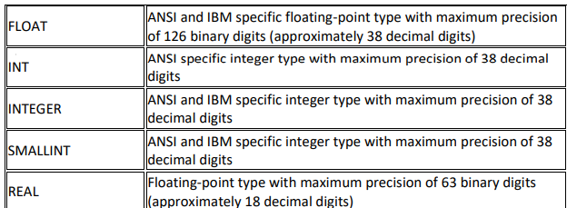

Slide 29
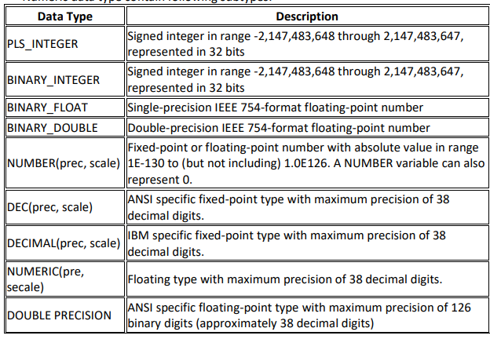

Slide 30
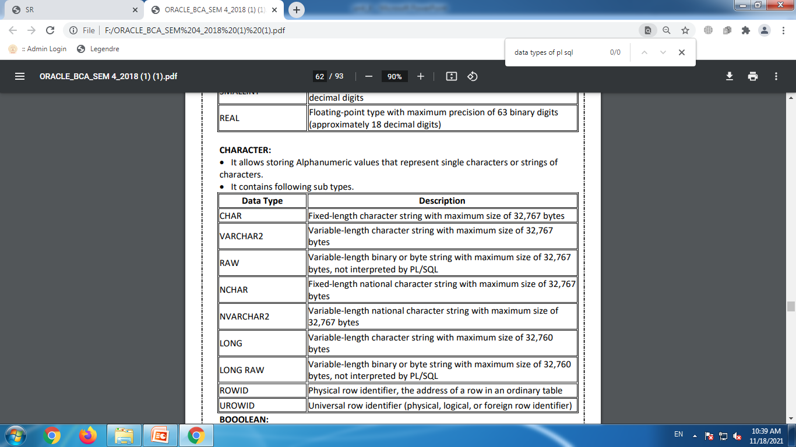

Slide 31
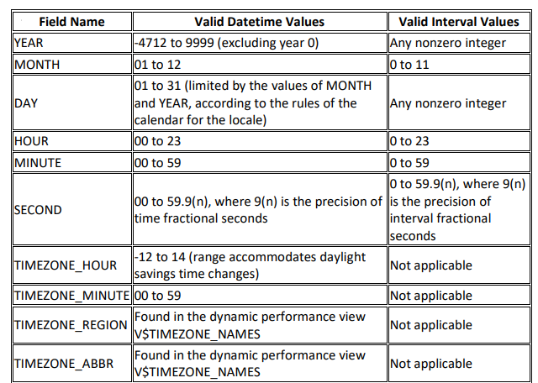

Slide 32
boolean
It allows storing Logical values on which logical operations are performed.
These logical values can be Boolean values TRUE and FALSE and NULL.

